Slide 1

HOUSING: PRICE PREDICTION
Machine Learning project

Slide 2
Contents
Problem statement and goal
Importing libraries
Exploratory data analysis(EDA)
Data Preprocessing
Model Building
Cross Validation and Prediction
Grid Search
Saving the model with joblib

Slide 3
Problem statement and goal
Data science comes as a very important tool to solve problems in the domain to help the companies increase their overall revenue, profits, improving their marketing strategies.
A US-based housing company named Surprise Housing has decided to enter the Australian market.
The company is looking at prospective properties to buy houses to enter the market.
You are required to model the price of houses with the available independent variables. This model will then be used by the management to understand how exactly the prices vary with the variables.
They can accordingly manipulate the strategy of the firm and concentrate on areas that will yield high returns

Slide 4
Importing libraries
import pandas as pd
import numpy as np
import matplotlib.pyplot as plt
import seaborn as sb
from scipy import stats
from sklearn.preprocessing import LabelEncoder
from sklearn.model_selection import train_test_split
from sklearn.linear_model import LinearRegression
from sklearn.linear_model import Ridge
from sklearn.linear_model import Lasso
from sklearn import metrics
from sklearn.model_selection import cross_val_score
from sklearn.model_selection import cross_val_predict
from sklearn.model_selection import GridSearchCV
from sklearn.externals import joblib
import warnings

Slide 5
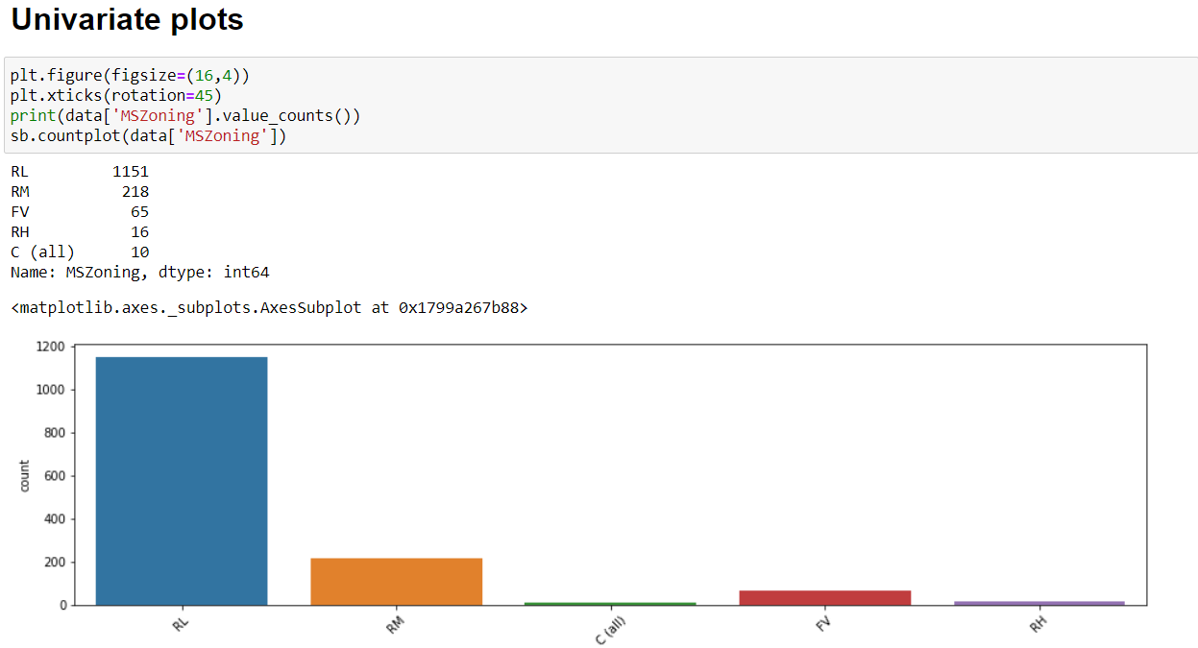
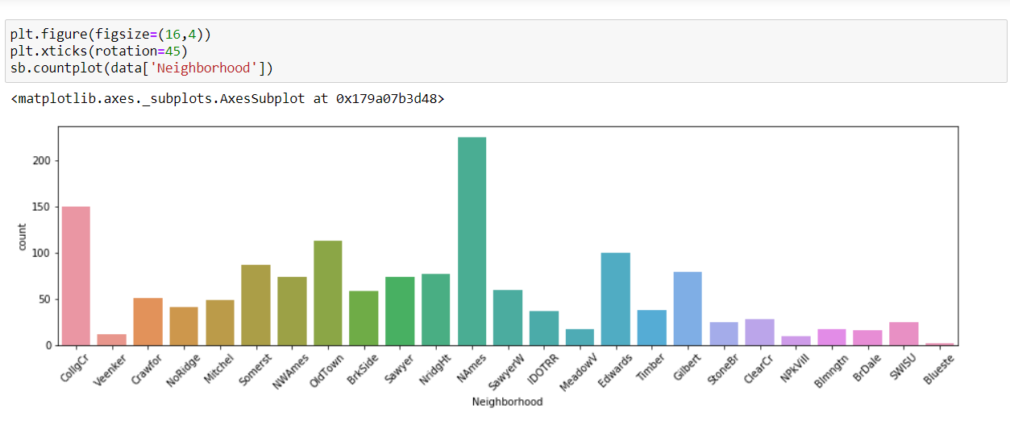
Exploratory data analysis(EDA)
In EDA process data analyzing, Univariate and bivariate plots .
In data analyzing we used data.shape, data.dtypes, data.nunique, data.isnull, data.describe and so on functions are used.
Univariate Plot

Slide 6
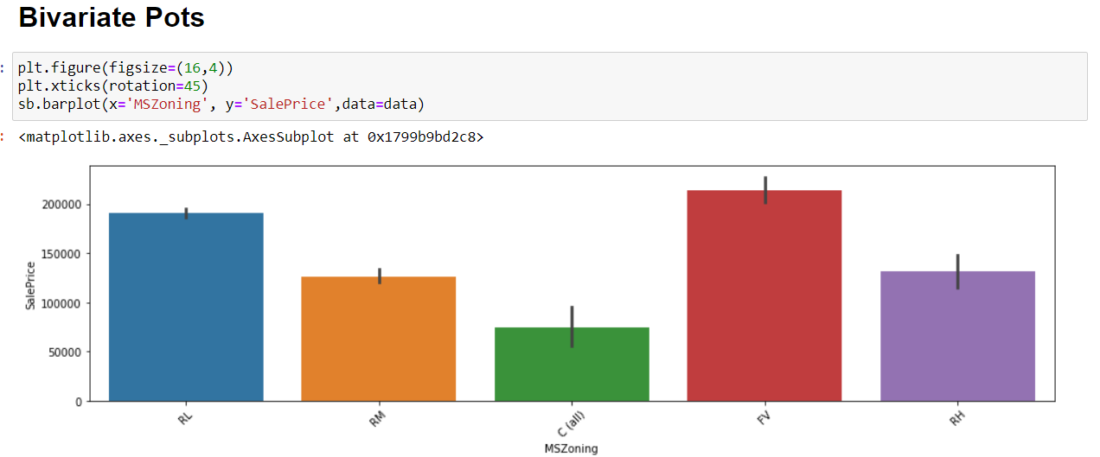
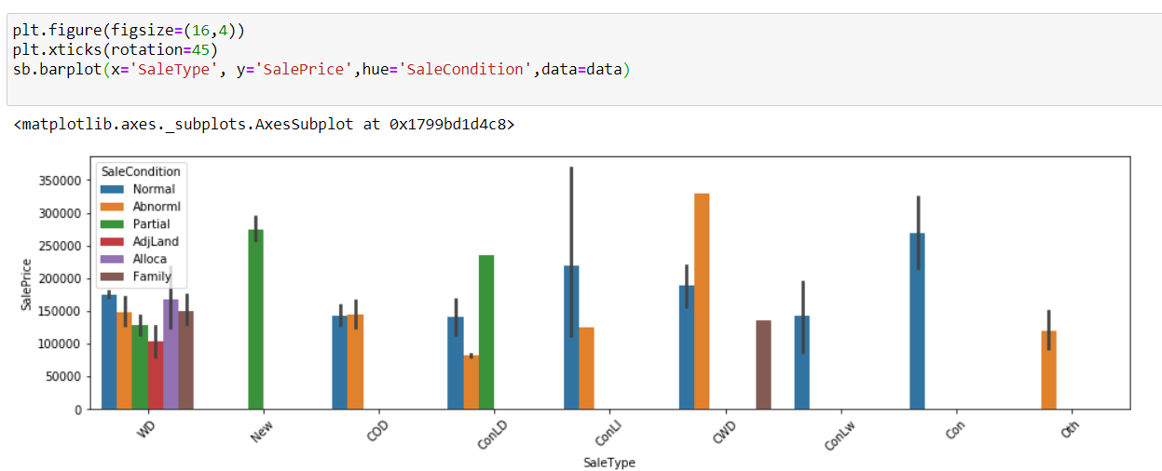

Slide 7
Data Preprocessing
Data preprocessing includes
Data cleaning
Cleaning includes droping of data
Data columns dropping
Dropped data columns with doesn't help with modeling
Data filling
Filling the columns with fiilna and mode and few columns with 0
Label encoding
Converting the non numerical data into numercial values

Slide 8
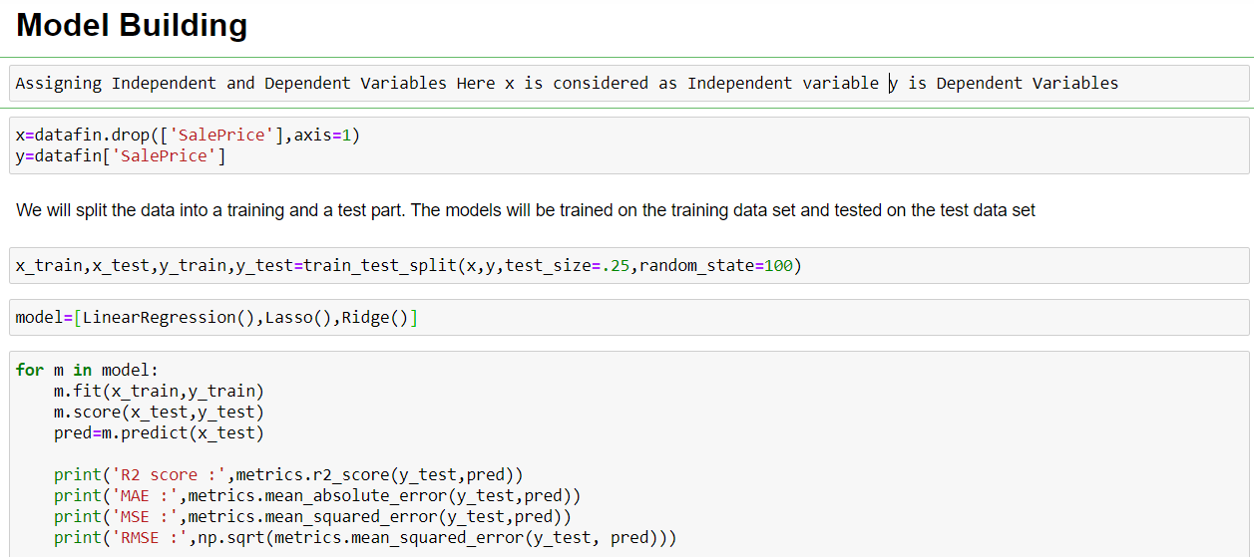
Model Building
After data is preprocessed , now it is ready for modeling.
Spliting data into x is considered as Independent variable y is Dependent Variables.
Training and testing data x_train,x_test,y_train,y_test=train_test_split(x,y,test_size=.25,random_state=100)

Slide 9
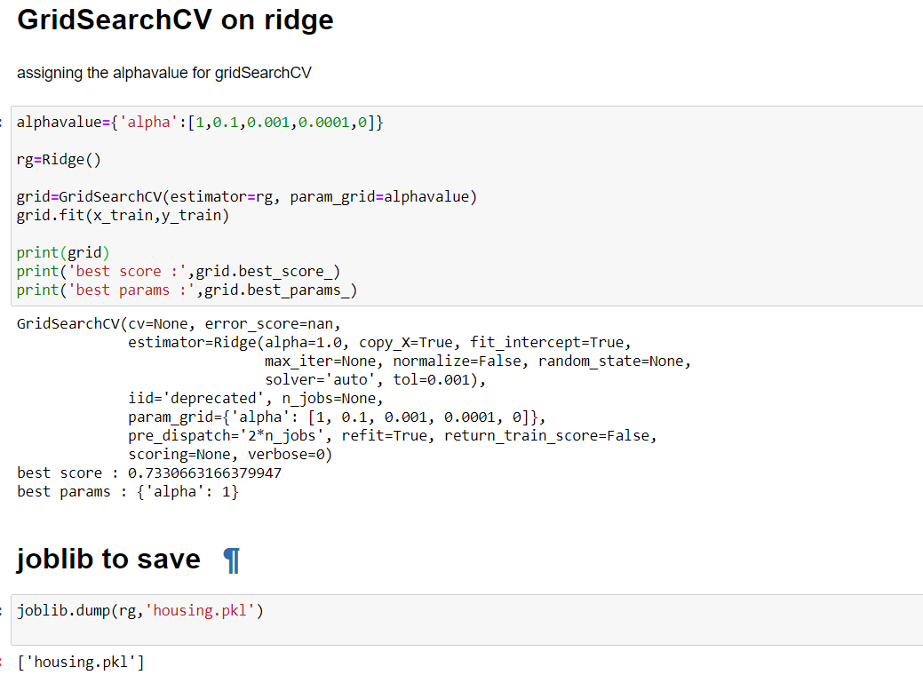
Grid Search and joblib
GridSearchCV implements a “fit” and a “score” method. It also implements “predict”, “predict_proba”, “decision_function”, “transform” and “inverse_transform” if they are implemented in the estimator used.
Joblib is used to save the model

Slide 10
conclusion
Data analyzing
EDA Process
Data preprocessing
Modeling
Through EDA process we gained a visualized insight of dataset.
Through Preprocessing we manipulate data and prepared the data for modeling
After performing all the above tasks we have gained a reasonable prediction.

